Slide 1
MIS 3301 Intro. to Business Programming Logic
Functions
Standard Library & Modules; Random Functions
Mrs. Nancy G. Sánchez

Slide 2
Standard Library
Standard Library
Consists of all functions that have been pre-written and are automatically installed when we install Python.
These functions are known as Library Functions.
Built-in Functions – built into the Interpreter and you just invoke them when needed.
print(), input(), float(), int(), format(), etc.
Modules
Modules are files containing additional functions. They are organized by topics.
In order to use these functions, you must import the module/file into your code.
Here are two that were installed when you installed Python
import random
import math

Slide 3
Random Module

Slide 4
Random Module
Generating Random Numbers
Integers
randint()
randrange()
Floating Points
random()
uniform()
Seed Value
seed()

Slide 5
Using Functions from a Module
Import the module
import random
def main():
num = random.randint(1,10)
main()
Use a dot notation
Then the function name
Preface the function
with the module name

Slide 6
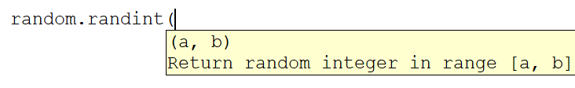
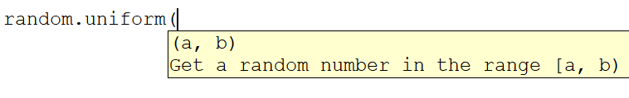
Python Syntax documentation
Inclusive [a, b]
Exclusive [a, b)

Slide 7
randint(start, stop_inclusive)
Generates a random integer between the start & stop values inclusive.
import random
def main():
num = random.randint(1,5) #inclusive
print('randint:', num)
main()
1st execution
randint: 2
Valid list: [a, b]
→ [1,2,3,4,5]
2nd execution
randint: 5

Slide 8
randrange(start, stop_exclusive, step)
Generates a random integer between the start & stop values exclusive.
import random
def main():
num = random.randrange(5)
print('randrange:', num)
main()
1st execution
randrange: 2
Valid list: [a, b)
→ [0,1,2,3,4]
2nd execution
randrange: 0
import random
def main():
num = random.randrange(1, 7, 2)
print('randrange:', num)
main()
1st execution
randrange: 5
Valid list: [a, b)
→ [1,3,5]
2nd execution
randrange: 3

Slide 9
random() → [0,1] i.e. inclusive
Generates a random floating point between 0 and 1 inclusive
import random
def main():
num = random.random()
print('random:', num)
main()
1st execution
random: 0.9509600623295121
2nd execution
random: 0.12575896782578933

Slide 10
uniform(start, stop_inclusive, step)
Generates a random floating point between the start & stop values inclusive
import random
def main():
num = random.uniform(1.0, 100.0)
print('uniform:', num)
main()
1st execution
uniform: 45.02491412454513
2nd execution
uniform: 90.71365505017872

Slide 11
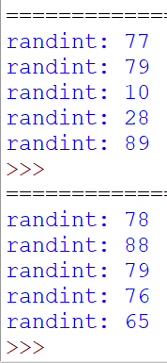
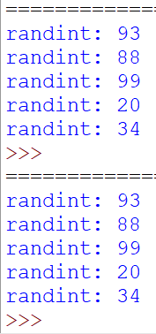
seed(value)
All of the random functions discussed here are Pseudorandom Number Generators
They use a seed value that is not random.
Without specifying a Seed Value: uses the system clock
Specifying a Seed Value
import random
def main():
for num in range(0, 5):
num = random.randint(1,100)
print('randint:', num)
main()
import random
def main():
random.seed(20)
for num in range(0, 5):
num = random.randint(1,100)
print('randint:', num)
main()

